Slide 1
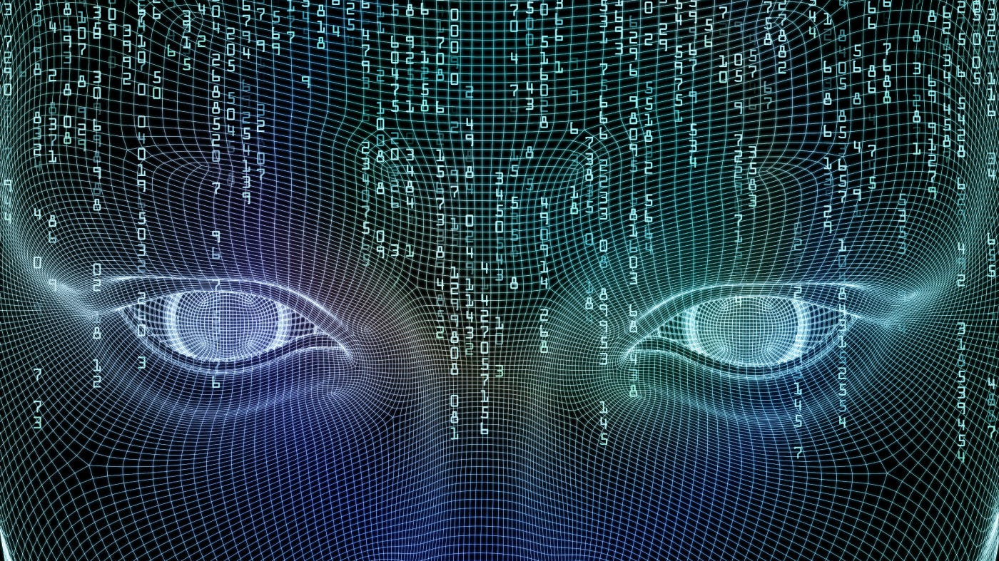
Historical Timeline of Computer Vision
By: Jesus Gudino
Professor: Anna Devarakonda
01/15/2025

Slide 2

Tracing the Evolution: 1960s to 2020s
The beginning of Computer Vision
1960s
1970s
Algorithms and Patterns Recognition
Advances in Edge Detection and Theory
1980s
1990s
Object Recognition and Real-Time Applications
Rise of Datasets and Deep Learning Foundations
2000s
2010s
The Deep Learning Revolution
Real-World Applications and Ethical Focus
2020s

Slide 3

1960
1963-Lawrence Roberts used computer analysis to extract 3D information from 2D images, a foundation step in computer vision.
1966-MIT’s “Summer Vision Project” attempted to develop object recognition systems.
1970
1974-Optical character recognition (OCR) gained momentum, enabling machines to read printed text.
1978-The concept of feature extraction emerged, which became crucial for object recognition.
1980
1980-The Canny Edge Detector algorithm was introduced, providing a powerful way to identify object boundaries in images.
1982-David Marr published Vision: A Computational Investigation, defining the stages of image processing: primal sketch, 2.5D sketch, and 3D model.

Slide 4

1990
1993-Real-time face detection systems were demonstrated, paving the way for security applications.
1997-Viola and Jones developed algorithms for robust object detection, including face detection.
2000
2000-The creation of large datasets like ImageNet revolutionized how vision systems were trained.
2006-Geoffrey Hilton introduced the concept of deep learning, laying the groundwork for modern vision breakthroughs.
2010
2010-Microsoft Kinect brought motion tracking and depth into consumer devices.
2012- AlexNet won the ImageNet competition using deep learning, demonstrating its power in visual tasks.
2014-GANs allowed machines to generate realist images.
2020
Self- driving cars used advanced vision systems for navigation.
2022-DALLE-E 2 showcased Ai’s ability to generate art from text.
2023-Ethical concerns, including AI bias and privacy issues, became central in computer vision research.

